Slide 1


Slide 2
Agenda
Basic overview: basic commands and use cases;
How Git works: commit structure, branching, remotes;
Non trivial use cases and useful tools;
Popular workflows: efficient ways of work with Git;
Git internal structure;

Slide 3
What we will learn
reg log
.git
commit
merge
stage
tag
rebase
branch
gc
checkout
origin
remote
reset
revert
fast-forward

Slide 4
What we will not learn
How to configure git on server;
GitHub, BitBucket details.
GUI;

Slide 5
What is Git
VCS (version) control system;
GNU General Public License version 2;
Implemented as set of command line commands;
Written on C, Shell, Perl, Python;

Slide 6

History of Git
1991–2002: changes to the Linux kernel were passed around as patches and archived files;
2002: the Linux kernel project began using a proprietary DVCS called BitKeeper;
2005: relationship between development community and producer of BitKeeper broken down;
2005: Linux development community started to develop own DVCS;

Slide 7
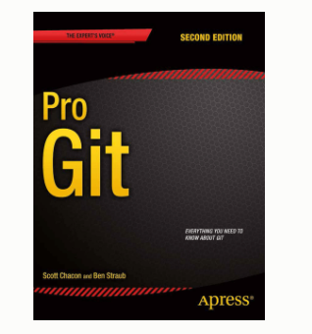
Learning resources
Pro Git Book;
Reference documentation (https://git-scm.com/docs or run git help)
Visual Git Reference (http://marklodato.github.io/visual-git-guide/index-en.html)

Slide 8
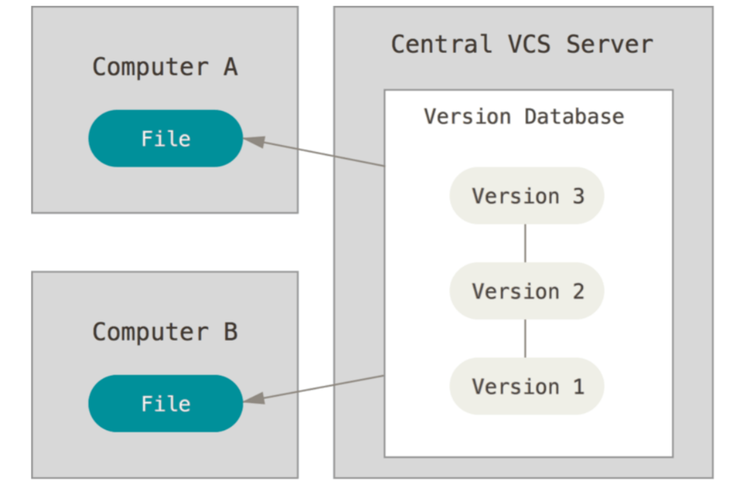
Centralized Version Control Systems
CVS, Subversion, etc.;
Clients check out the latest snapshot of the files;
Single point of failure;

Slide 9
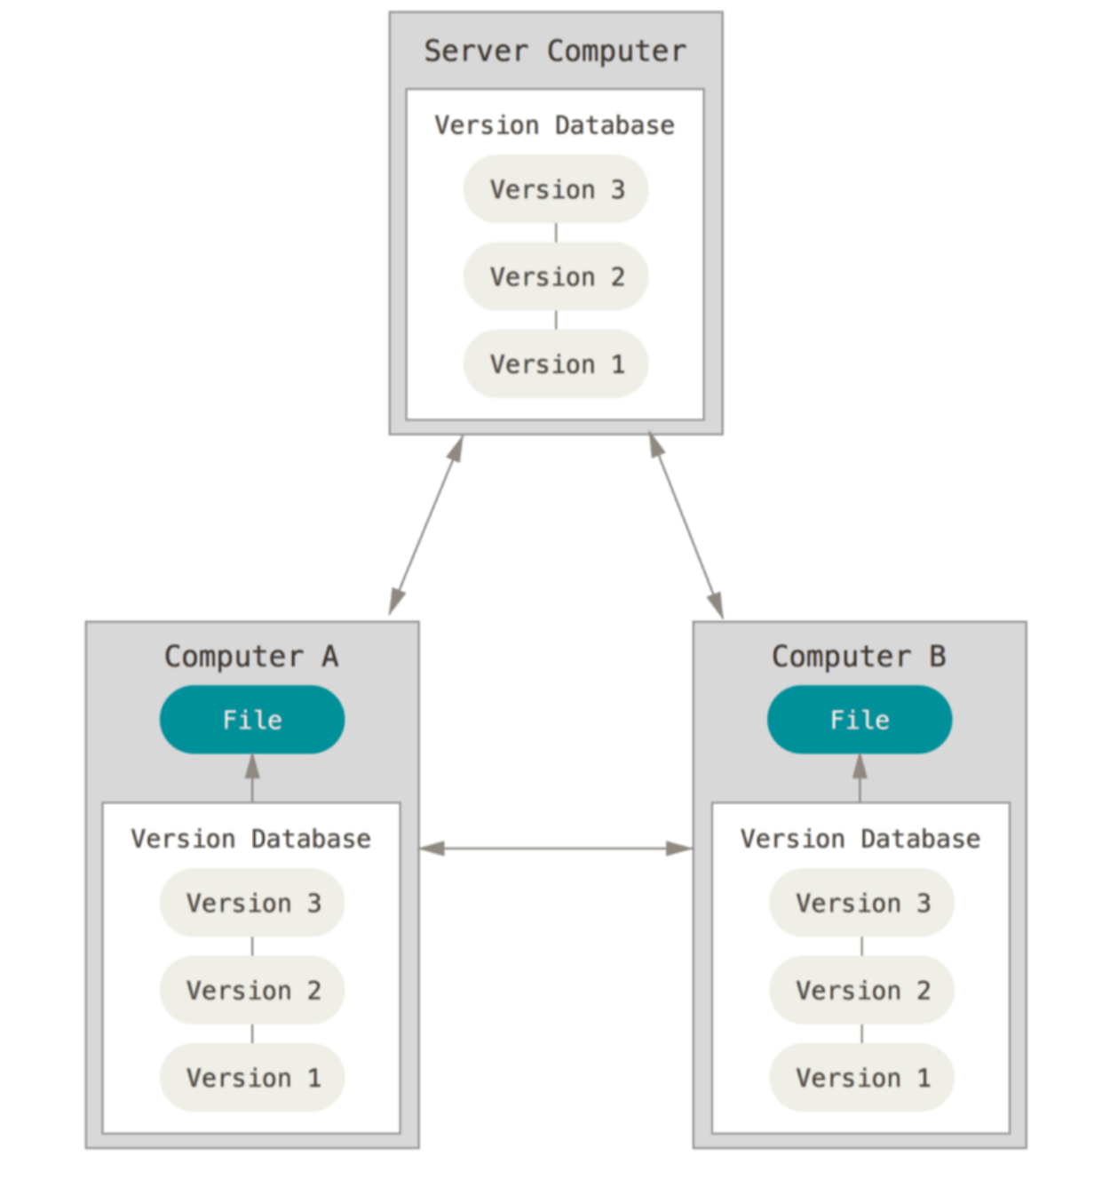
Distributed Version Control Systems
Git, Mercurial;
Clients fully mirror the main repository;

Slide 10
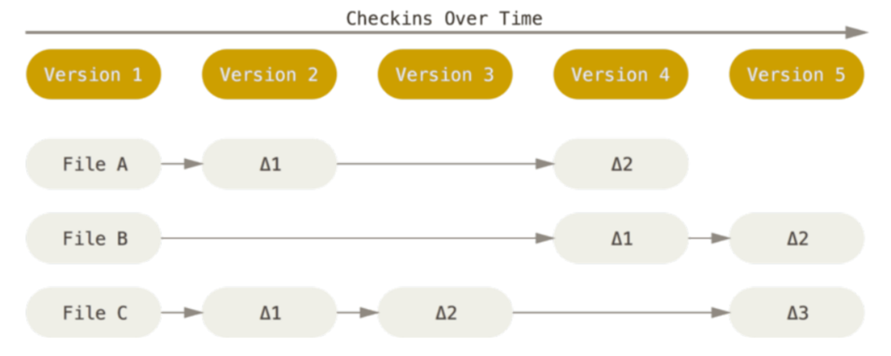
How most CVCS store data
Stores only deltas

Slide 11
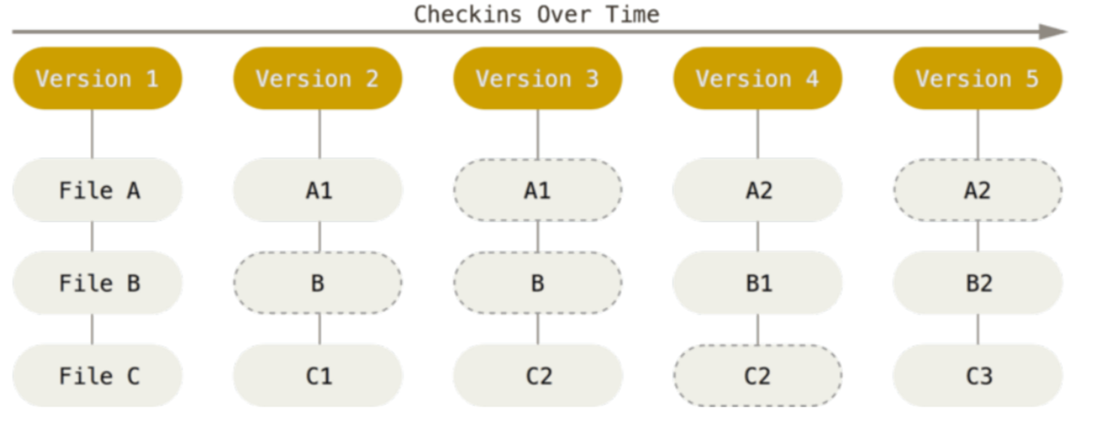
How git stores data
Each version stores full snapshot of filesystem. For files that are not changed, stores
pointers to the previous version

Slide 12
Pros of Git
Almost all operations are local;
Integrity: snapshots are check-summed and referenced by a checksum (SHA1);
If data is sored, there is almost no way to loose the data;
Popular;

Slide 13
Cons of Git
Complexity
Ability to change history (history is not really trustworthy);
Commits don’t have numbers (only sha1 hashes);

Slide 14
First-Time Git Setup

Slide 15
Git is command line tool
Git was designed as command line tools
It is better to use it from command line
(without using GUI)

Slide 16
Git config types
Config | Where is stored | How to set
System | /etc/gitconfig | git config --system
Global | ~/.gitconfig | git config --global
Local | $repo/.git/config | git config --local
git config --list displays all set config values

Slide 17

Identity Configs
Allows to set user name and email that will be included to the commit information
git config --global user.name “Dmitry Kavtur”
git config --global user.email dmitrykavtur@coherentsolutions.com

Slide 18
Initializing a Repository in an Existing Directory
git init
creates a new subdirectory named .git that contains all Git repository files
Creates empty branch master

Slide 19
Cloning an Existing Repository
git clone https://github.com/kavtur/repo1
That creates a directory named “repo1”;
Creates a .git directory inside it;
Pulls down all the data for that repository
Checks out a working copy of the latest version.

Slide 20
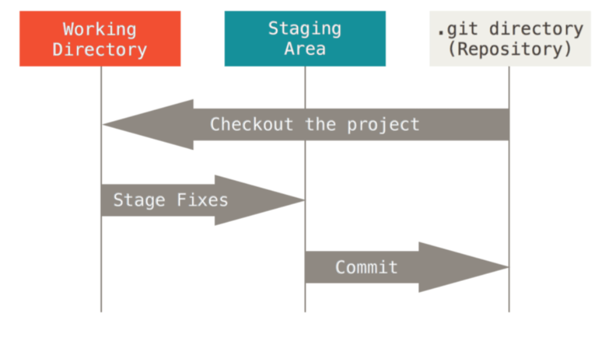
Three statuses of files

Slide 21
Staging changes
git add f1.txt
Adds modified file f1.txt to the staged area

Slide 22
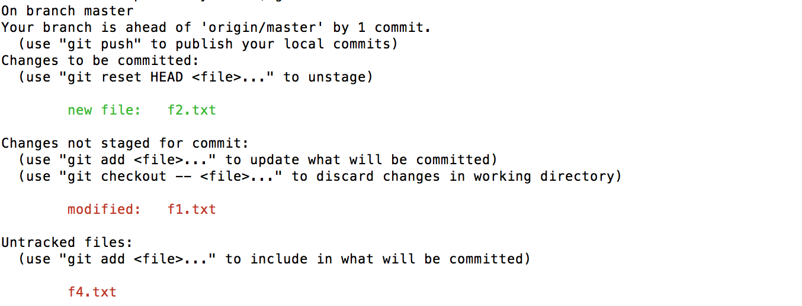
Checking the Status of Your Files
git status

Slide 23
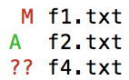
Status short version
git status –s
right column – status of working directory
left column – status of staging area

Slide 24
Ignoring Files
Files can be ignored if don’t want that git shows them in any statuses;
Files should be listed in .gitignore
Standard ignore files for various languages are at https://github.com/github/gitignore
Can be set globally
git config --global core.excludesfile ~/.gitignore_global

Slide 25
.gitignore format
* zero or more characters
[abc] any character inside the brackets
? Single character
[a-z] any character between a and z
! negates pattern;
/build/**/abc

Slide 26
.gitignore format examples
abc – all files and folders with name abc
abc/ - all folders with name abc
/dir1/**/abc/* - content of all dirs abc that are subdirs of dir1
*.class – all files with the exstension class

Slide 27
View changes

Slide 28
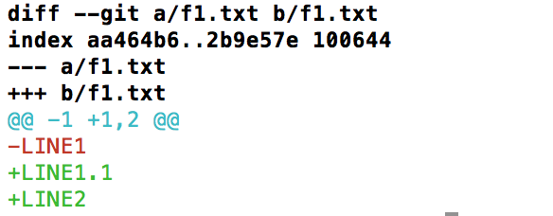
View working dir changes
Compares working dir state of changed files with the staged version
git diff [path]
Note: the output is unified diff format

Slide 29
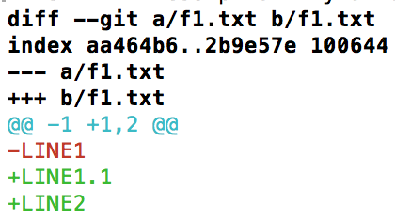
View staged changes
Compares staged changes with the last committed state
git diff --staged [path]

Slide 30
Compares working dir with last commit
Compares staged changes with the last committed state
git diff HEAD

Slide 31
Commit changes
Stores the current contents of the index to the new commit object and put it to the repository
git commit
not directly perform commit operation but run default system editor or git configured (core.editor ) editor to enter the commit message

Slide 32
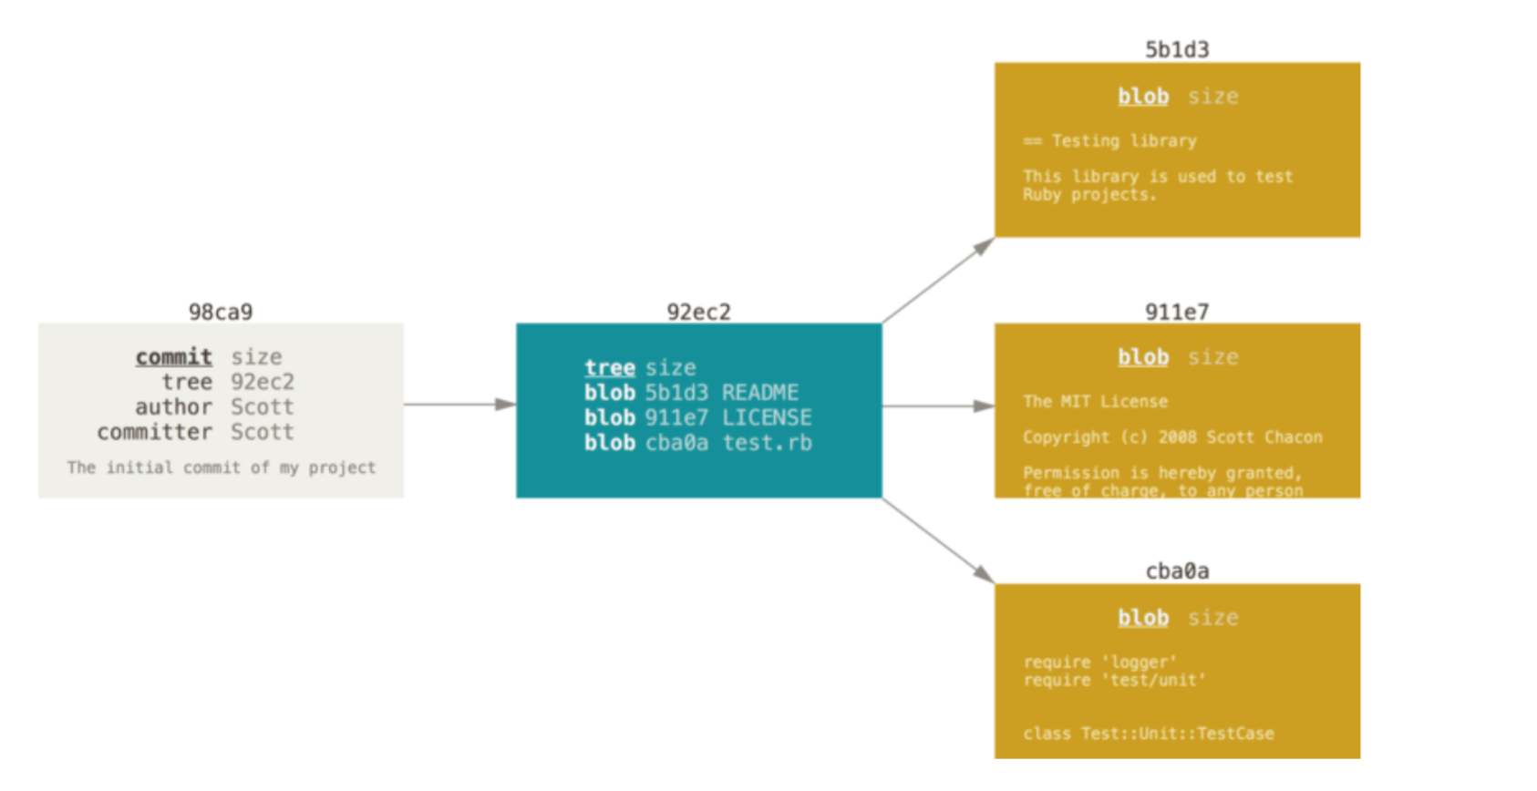
Git commit structure
Checksums each subdirectory
Blob with content of each file
Stores tree structure
Note: git cat-file –p commit_hash allows to see commit structure

Slide 33
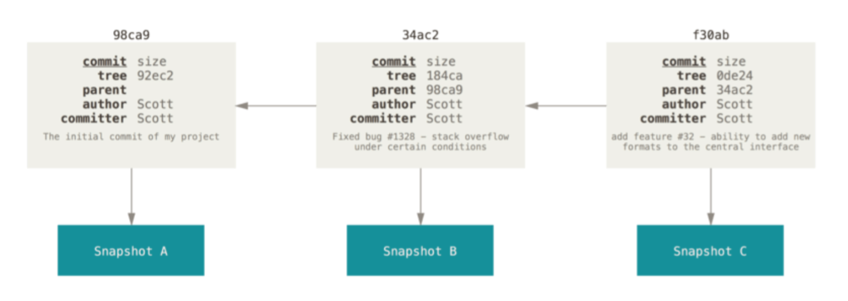
Git commits history
Each commit stores pointer to the previous commit (commits)

Slide 34
Commit changes specifying message
git commit –m “commit message”
doesn’t run editor and performs commit right away

Slide 35
Commit not staged changes
git commit -a -m “commit message”
commit all working dir changes and staged changes;
allows to skip git add;
do not commit untracked files;

Slide 36
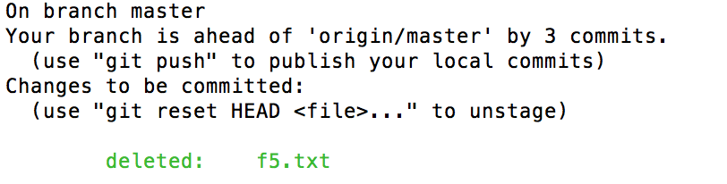
Removing files
git rm f.txt
physically removes file from file system and stages this change
Note: if you simple remove file (using rm command) you will need to stage this change manually (performing git add)

Slide 37
Removing files

Slide 38
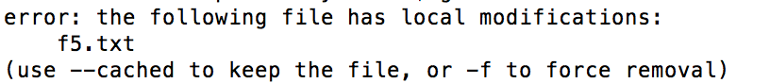
Removing modified files
If you have modified tracked file, have not staged changed and try to remove the file, git prevents it
You should use
git rm -f f5.txt

Slide 39
Remove file from index but keep locally
If you want to remove file from index (don’t want git to track this file anymore)
git rm --cached f1.txt
This is useful, when file that should be in .gitignore was accidentally committed

Slide 40
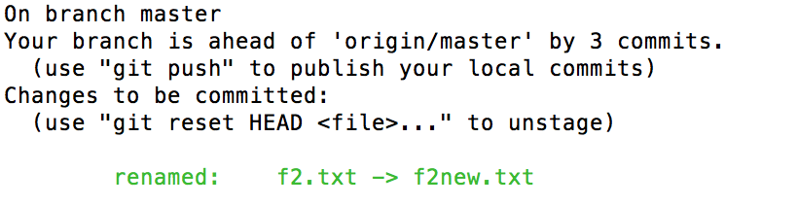
Renaming (moving) files
git mv f2.txt f2new.txt
This is equivalent of running
mv f2.txt f2new.txt
git rm f2.txt
git add f2.new.txt

Slide 41
Viewing history

Slide 42
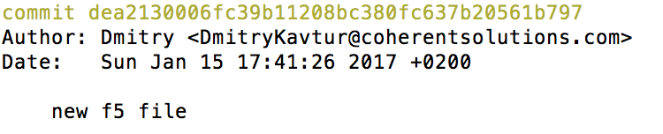
View history
git log [file]
Show latest 10 commits information in the form of

Slide 43
git log useful use cases
-{i} shows only i commits;
-p shows in addition commit changes;
--stat show statistic: how many, added, deleted, modified;
--pretty=oneline, --oneline
--pretty=format:”format_string”
--graph show branch merge history

Slide 44
Limiting log output by date interval
--since --until allow to specify time interval to show commits info
--since=“2016-12-07”
--since=“1 month 2 weeks”

Slide 45
Limiting log output by search criteria
--author
filter a particular author
--grep
filter particular commit message

Slide 46
Limiting log by code change
-Sabc
Shows only commits that have added or removed abc in the source code

Slide 47
Branching

Slide 48
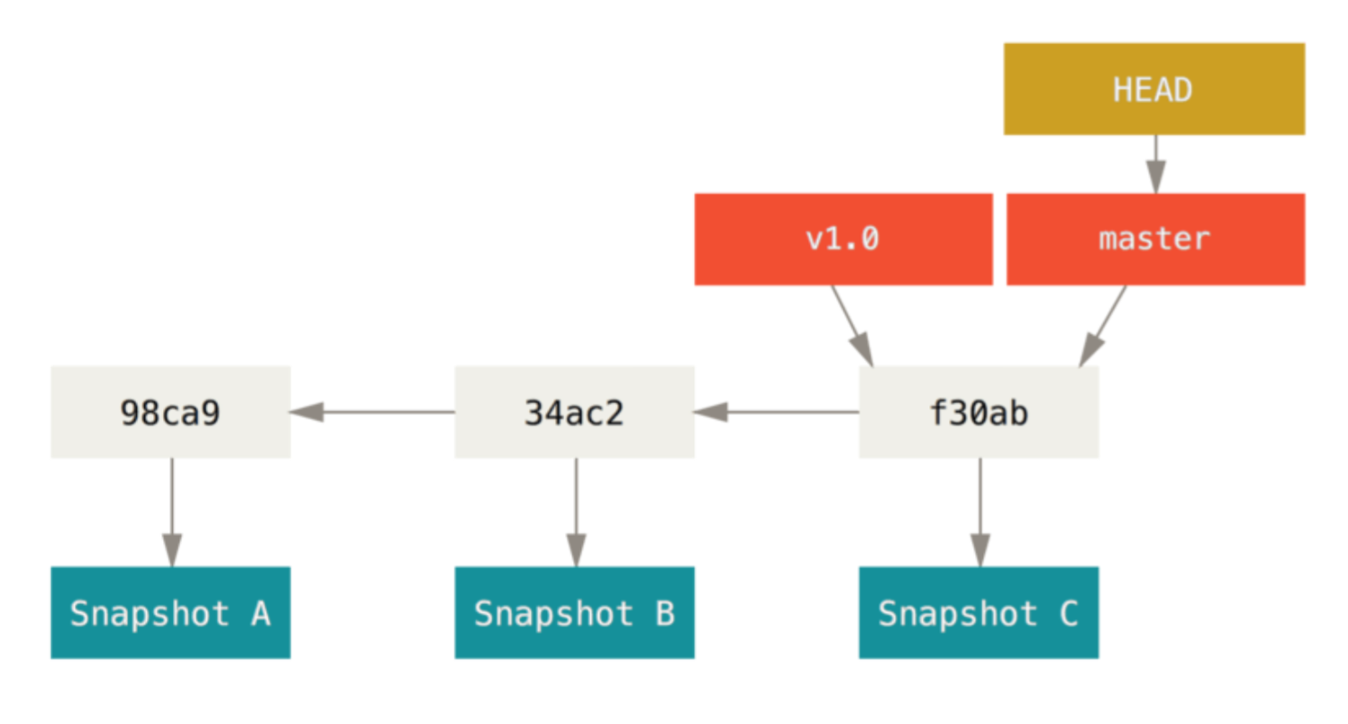
Branch
Git Branch is simply a lightweight movable pointer to one the commits
If you commit to current branch, the pointer moves;
HEAD here is the pointer to the latest commit of the active branch

Slide 49
Create branch
git branch branch-name
Creates new pointer but doesn’t change HEAD
HEAD
master
new_branch
c1
c2
c3
Note: git log --oneline –decorate shows all pointers info

Slide 50
Switching the branch
git checkout branch_name
Changes HEAD pointer to specified branch, replaces working directory changes with the state of branch
git checkout -b branch_name
Creates new branches and checkouts to it
Note: if you have some un-commited changes that conflict with files that are replaced, git will not allow it and will suggest to commit or stash changes firstly

Slide 51
Merge
git merge branch_to_merge_from
Incorporates changes from branch_to_merge_from to the current branch (where HEAD points). It applies all the changes since the time when their histories diverges

Slide 52
Three-way: State Before Merging
HEAD
master has unique commit c3
new_branch has unique commits c4, c5
master
c1
c2
c3
git merge new_branch
c4
c5
new_branch

Slide 53
Three-way: State After Merging
HEAD
master
c1
c2
c3
c6
c4
c5
new_branch
Replay the changes made on new_branch since it diverged from master (i.e., c2) until its current commit (C5) on top of master, and record the result in a new commit with two parent commits

Slide 54
Fast forward: State Before Merging
HEAD
new_branch has commits c4, c5 that are directly ahead of c2 (commit from new_branch was created)
master
c1
c2
c4
new_branch

Slide 55
Fast forward: State After Merging
Master pointer is just moved(no additional merge commit)
HEAD
c1
c2
master
c4
new_branch

Slide 56
Prevent fast-forward
git merge branch_to_merge_from --no-ff
Create a merge commit even when the merge resolves as a fast-forward.
Another usefull flag --ff-only – performs merge only if ff is possible

Slide 57
Delete branch after merge
Since main branch has all changes that were introduced in current branch, it worth to delete branch after merge in most cases
git branch –d branch_to_delete it will reject the deletion if the branch was not merged yet in the main branch. It is possible to specify –D (instead -d) to force the deletion

Slide 58
Find merged and unmerged branches
git branch --merged
Only list branches whose tips are reachable from the specified commit (HEAD by default)
git branch --no-merged
Only list branches whose tips are not reachable from the specified commit (HEAD by default)

Slide 59
Merge Conflicts
If you changed the same part of the same file differently in the two branches you’re merging together, Git won’t be able to merge them cleanly
Git adds standard conflict-resolution markers to the files that have conflicts

Slide 60
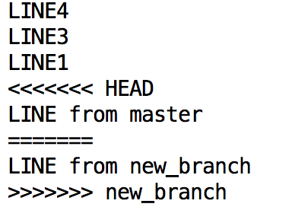
Conflicts resolution: Manually
Manually by removing conflict markers
Current branch
Branch that was trying to merge

Slide 61
Conflicts resolution: using merge tool
git mergetool
will run merge tool that is configured by merge.tool configuration variable or will ask what tool to use

Slide 62
Remote repository

Slide 63
Remote repository
Remote repository – is a version of your repository that is hosted somewhere
C1
C2
C3
C4
C1
C2
C3
C4
C5
C5

Slide 64
View your remoted
git remote – show list of remote aliases
git remote –v show list of remote aliases with remote urls

Slide 65
How to configure remote
When you clone remote repository, your local repository will have automatically single remote origin configured;
git remote add [repo_name] repo_url

Slide 66
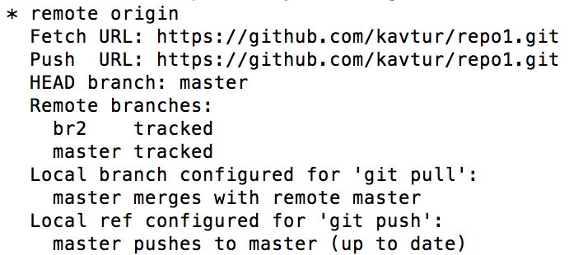
Showing remotes info
git remote show - displays list of known remotes
git remote show [remote-name] – displays information about urls, tracked branches, etc

Slide 67
Renaming/removing remote
git remote rename [old-remote-name] [new-remote-name] - renames remote (changes the alias)
git remote rm [remote-name] - removes

Slide 68
Pushing data
Publishing (sharing) your local changes to remote reposiory
git push [remote-name] [branch-name]
It pushes successfully if remote repository don’t have any changes that you have (somebody has pushed in the meantime)

Slide 69
Fetch information from remote repo
git fetch [repo_name]
Fetches all the information (commits, branches, tags) from remote repository that you don’t have at your local.
Note: it doesn’t merge any data to the branch where you work

Slide 70
Remote branches

Slide 71
Remote branch
Remote branch is a pointer in your remote repositories;
You can’t move that pointer locally;
It works like a bookmark to remember where remote branch was when you perform network communication;
It moves each time you perform any network communication with remote;
git remote show remote_name show remote branches info of the specified remote

Slide 72
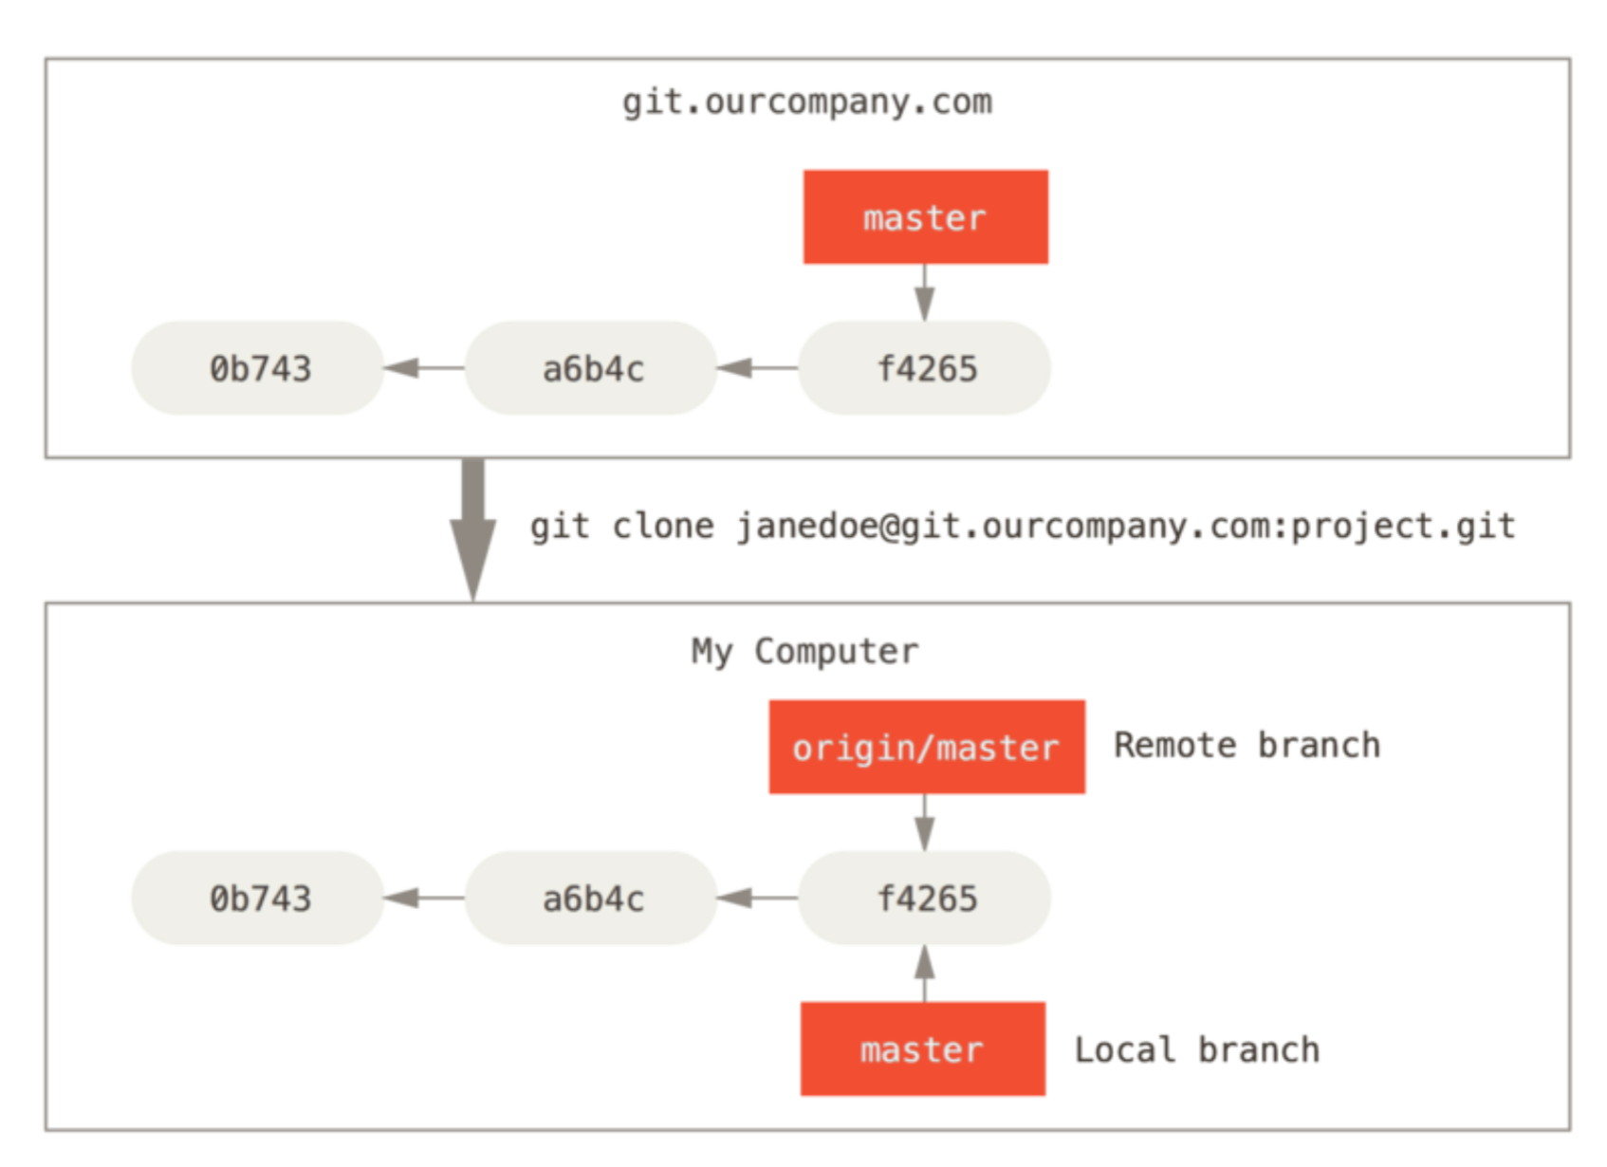
Remote are created when you clone

Slide 73
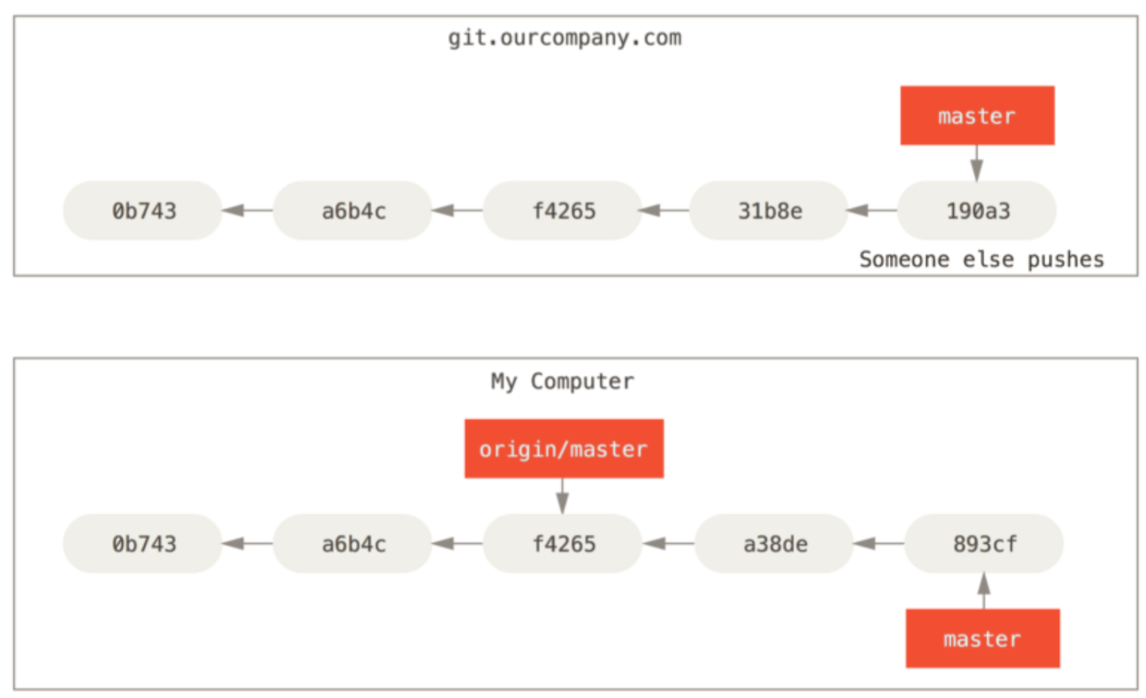
When somebody else committed some work
Your local origin/master pointer is out of sync with remote state

Slide 74
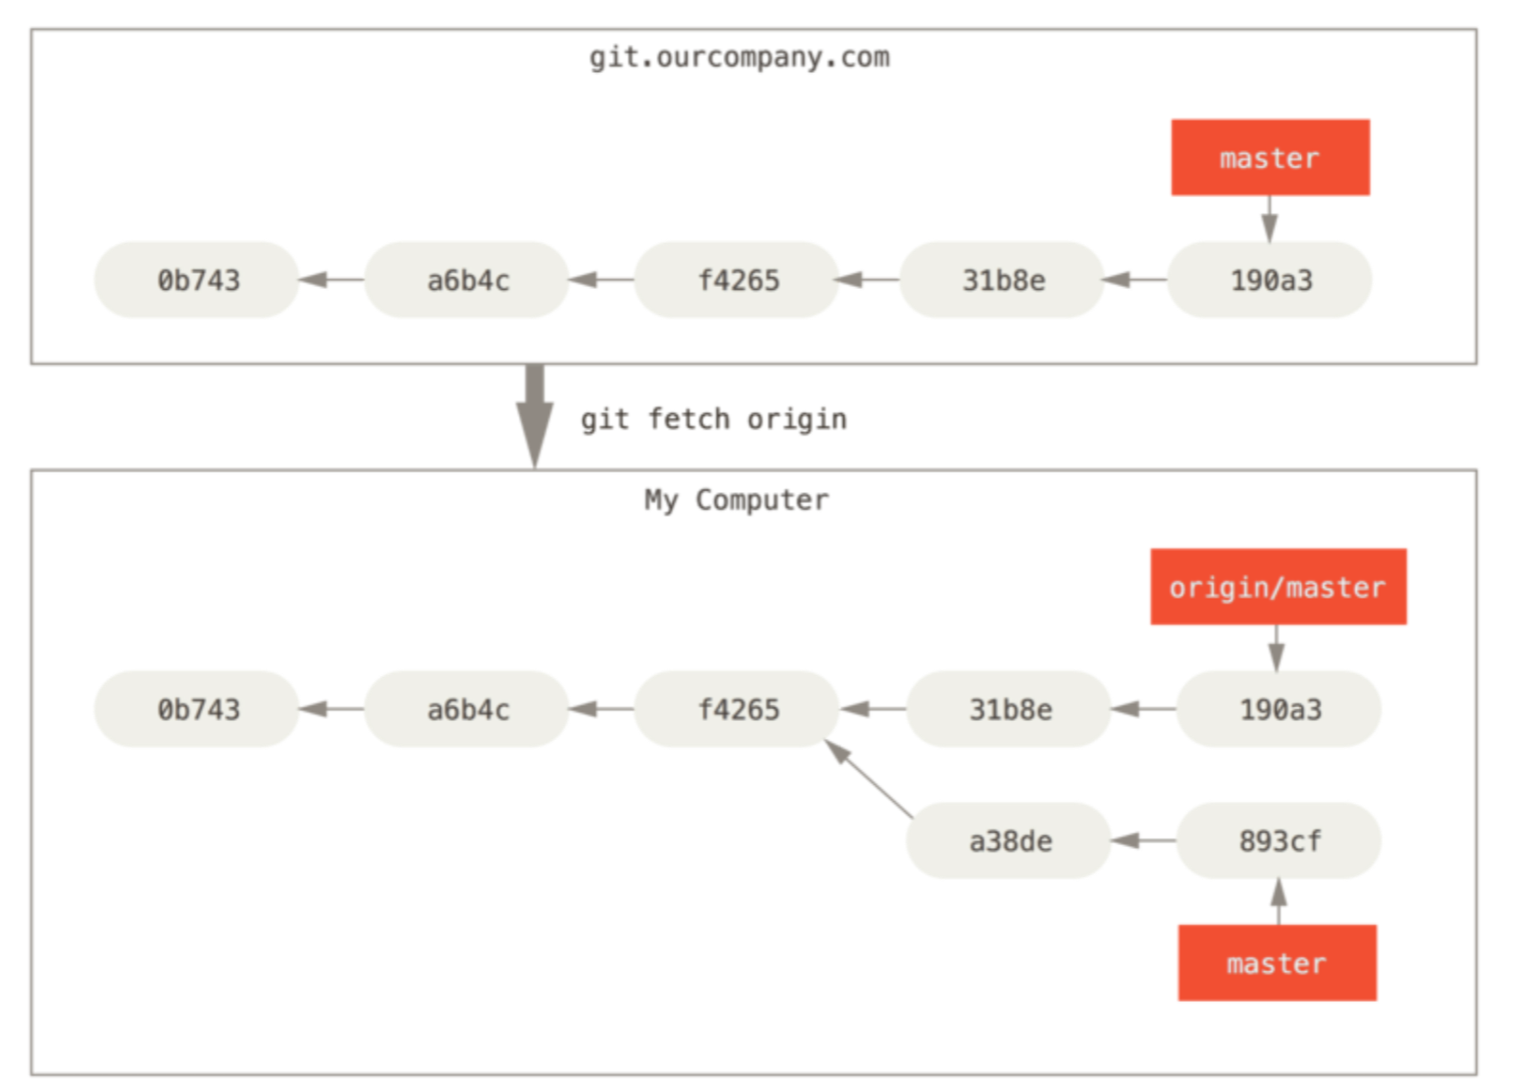
Fetch remote state
Now you can execute
git merge origin/maser to merge two branches

Slide 75
git push
git push remote_name branch_name
Sends you changes to remote server
After it, your branch and remote branch point to the same commit

Slide 76
git pull
git pull remote_name branch_name
git fetch remote_name
git merge remote_name/branch_name
The same as

Slide 77
See tracking branches
git branch –vv

Slide 78
Tracking branches
Tracking branches - are local branches that have a direct relationship to a remote branch.
git pull automatically knows which server to fetch from and branch to merge into. (no need to specify git pull remote_name branch_name)

Slide 79
How to set tracking
When you clone remote repo, master branch automatically is created tracking remote/master;
git checkout branch_name – if branch_name doesn’t exist and name matches name of one of remotes it creates local branch automatically tracking remote
git branch -u remote/branch_name set tracking explicitly
git push --set-upstream remote branch_name

Slide 80
Tag
Tag is a point if the history that is important.
Typically could be used to mark a release:
v1.0
v1.1-rc1

Slide 81
Types of tag supported by Git
Lightweight tag – pointer the specific commit;
Annotated tag – in addition provides additional information: checksum, tagger name, date, tag message, can be signed if needed
Note: tags are like branches but not changeable

Slide 82
Creating tag
Lightweight tag:
git tag tag_name [commit hash]
Annotated tag:
git tag –a tag_name –m “tag message” [commit hash]

Slide 83
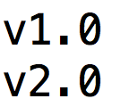
Listing tags
git tag
git tag –l “v2*” with the search pattern

Slide 84
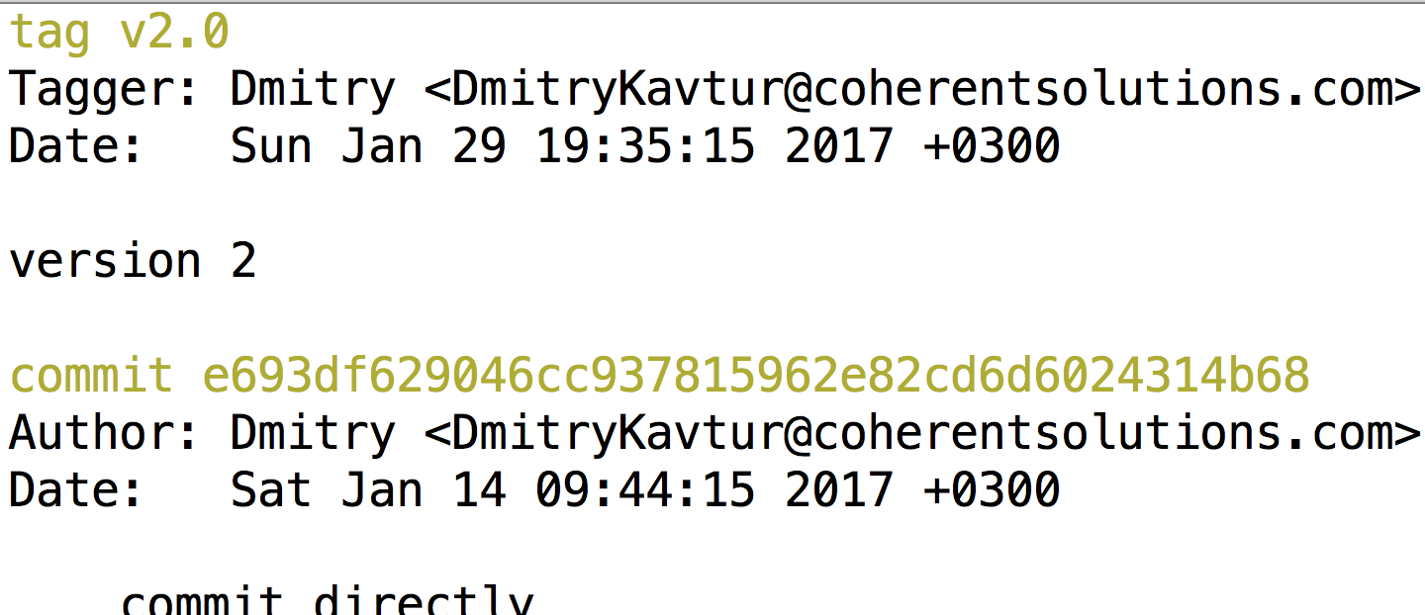
Displaying tag info
git show tag_name

Slide 85
Pushing tags
By default git doesn’t push any tags
git push remote_name tag_name to push tag_name
git push remote_name --tags to push all local tags

Slide 86
Checking out tag
Note: If you try to checkout tag directly (git checkout tag_name), you will be pointed to the tagged commit but became in the detached HEAD state (you can work and commit, but no branch is associated with it)
git checkoit –b branch_name tag_name checkouts state of tag and creates named branch with it

Slide 87
Tagging

Slide 88
Rebasing

Slide 89
Rebase: State Before
master has unique commit c3
new_branch has unique commits c4, c5
origin/master
c1
c2
c3
c4
c5
HEAD
master
git checkout new_branch
git rebase master
git rebase --onto master new_branch~1 new_branch

Slide 90
Rebase: State After
c4, c5 changes stored in temporal area
new_branch is reset to c3;
Changes of c4, c5 are applied ahead of c3 as c4*, c5*
HEAD is moved to C5*;
C4, C5 are abandoned (exist but no brunch is pointed)
master
`
c1
c2
c3
C4*
C5*
new_branch
c4
c5
HEAD

Slide 91
Rebase usecase1: before rebase
HEAD
master
c1
c2
c3
development
c4
c5
c8
c6
c7
git rebase --onto master development topic
topic

Slide 92
Rebase usecase1: after rebase
HEAD
topic
master
c6*
c7*
c1
c2
c3
development
c4
c5
c6
c7

Slide 93
Rebase usecase2: before rebase
HEAD
topic
c1
c2
c3
c4
c5
git rebase --onto topic~4 topic~2 topic
Note: branch~n means here n-th parent of branch

Slide 94
Rebase usecase2: after rebase
HEAD
topic
C4*
C5*
c1
c2
c3
c4
c5
As a result, changes of commits c2, c3 where removed

Slide 95
Rebase: in case of conflicts
In case of conflicts it stops at the first conflicted commits and allows you
Resolve conflict, commits changes and execute git rebase --continue
Or execute git rebase --abort to abort rebase and revert everything;

Slide 96
Pull rebase
git pull --rebase
Fetches changes from remote and rebases your local changes at top of remote (instead of merge in case of regular pull)

Slide 97
Rebase rule
Do not rebase commits that exist outside your repository!
Because rebase rewrites history and someone could already based work on commits that will be deleted

Slide 98
How to revert merge
https://www.kernel.org/pub/software/scm/git/docs/v1.6.3.2/howto/revert-a-faulty-merge.txt
git revert commit_hash

Slide 99
Reset and checkout

Slide 100
3 threes managed by git
HEAD
Index
Working
Dir
Last commit snapshot,
Next parent
Proposed next commit snapshot (stage area)
Sandbox

Slide 101
Working directory
The tree are the files that actually unpacked to the current directory;
Represents sandbox: some change can be tried here without storing any data;
tree displays the tree;

Slide 102
Index (Stage Area)
The three is stored inside .git folder;
Represents proposed next commit;
git ls-files –s displays the tree;

Slide 103
HEAD
Tree stores inside .git folder;
Represents snapshot of last commit;
git ls-tree -r HEAD displays the tree;

Slide 104
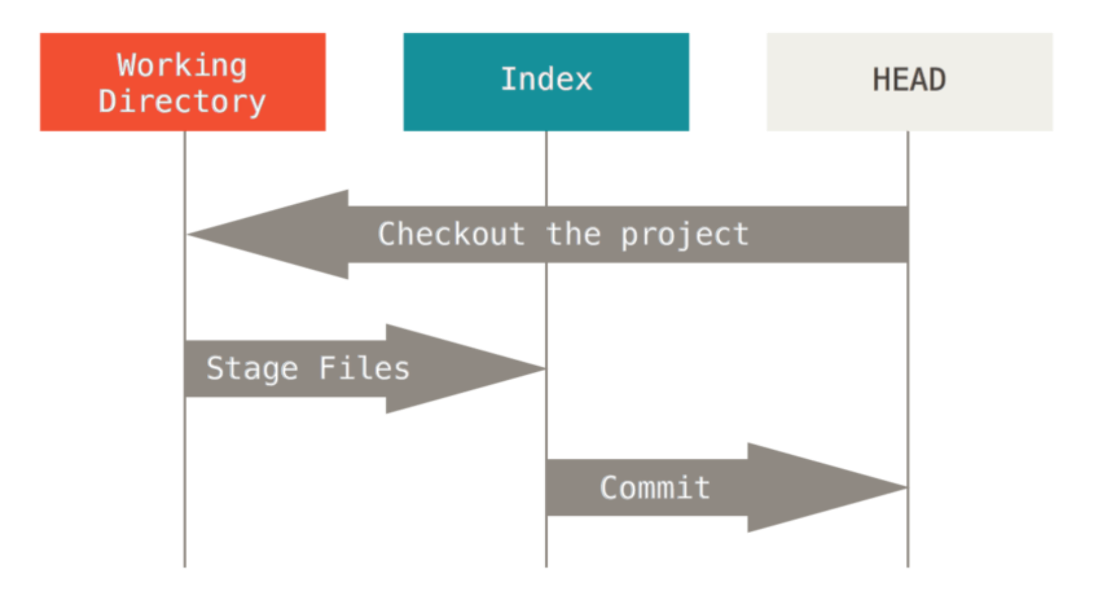
3 threes The Workflow

Slide 105
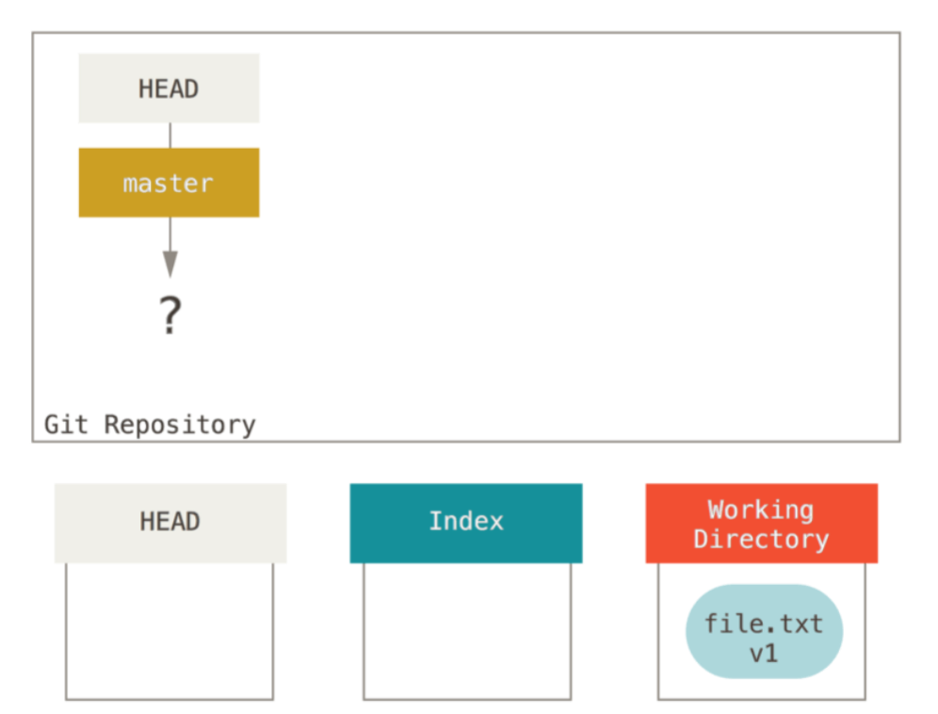
File in working dir
git init
Branch master is created but has no pointer
File is created at working dir

Slide 106
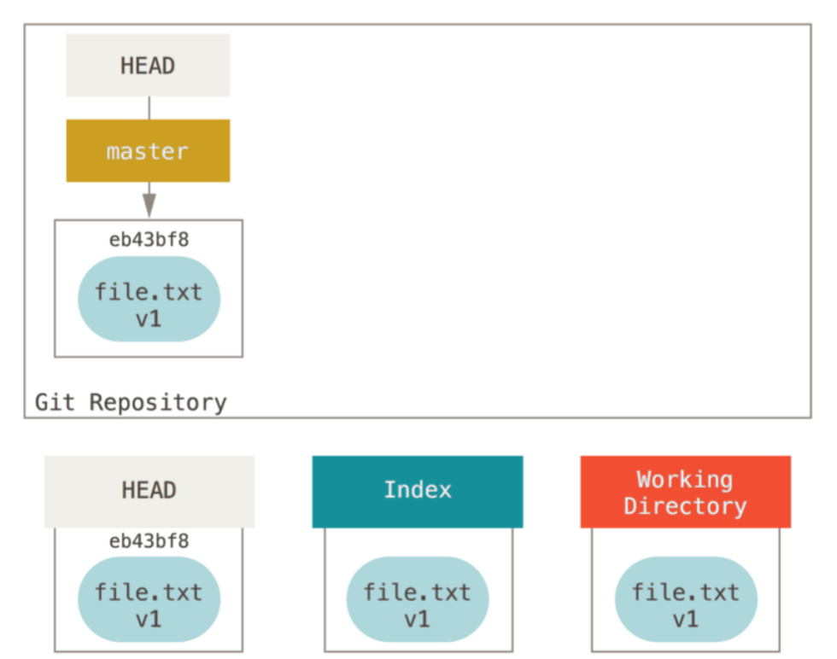
Index is committed
git commit

Slide 107
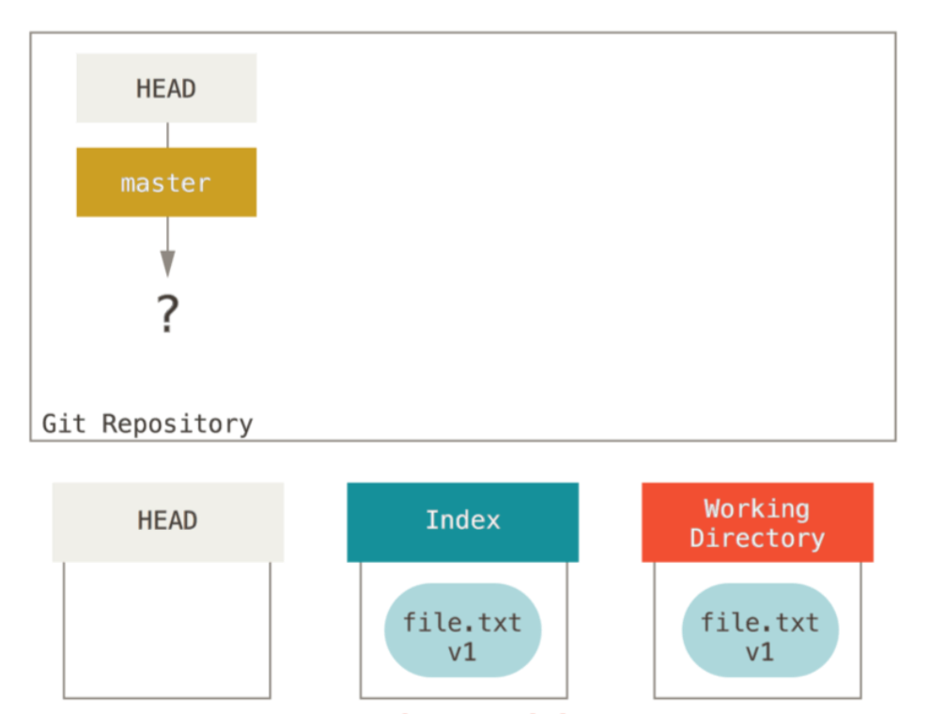
File added to index
git add file.txt

Slide 108
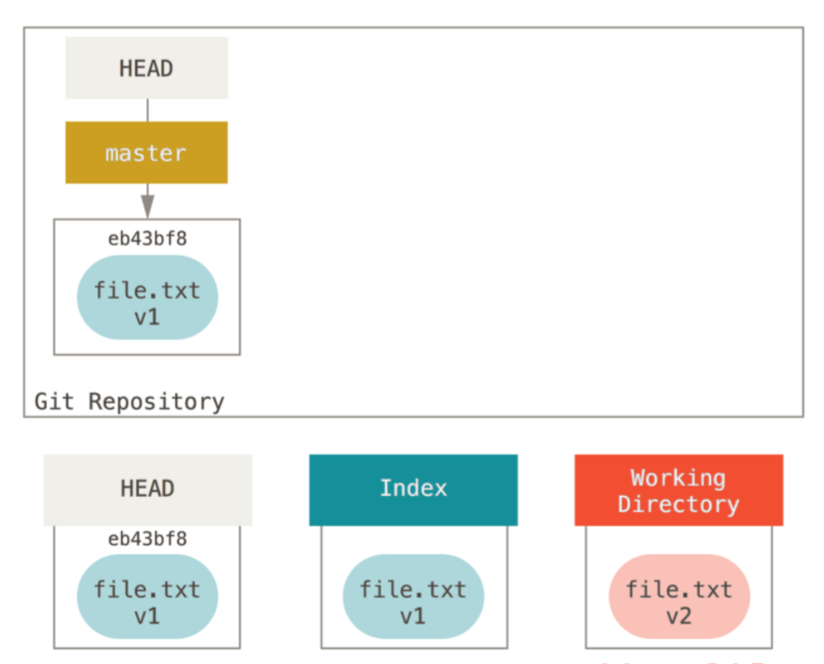
File is modified in working dir

Slide 109
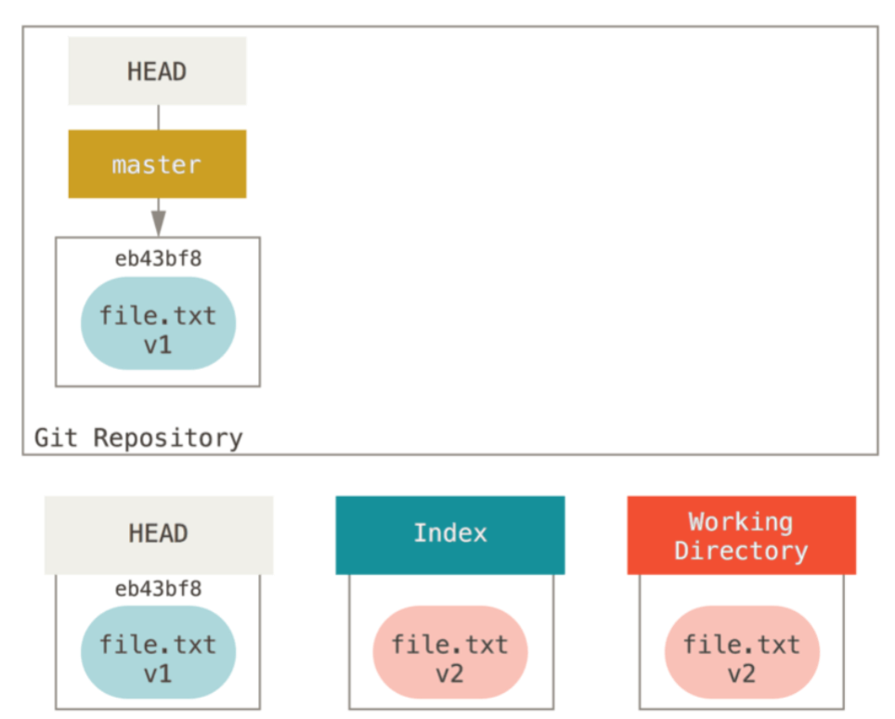
Changes are staged
git add file.txt

Slide 110
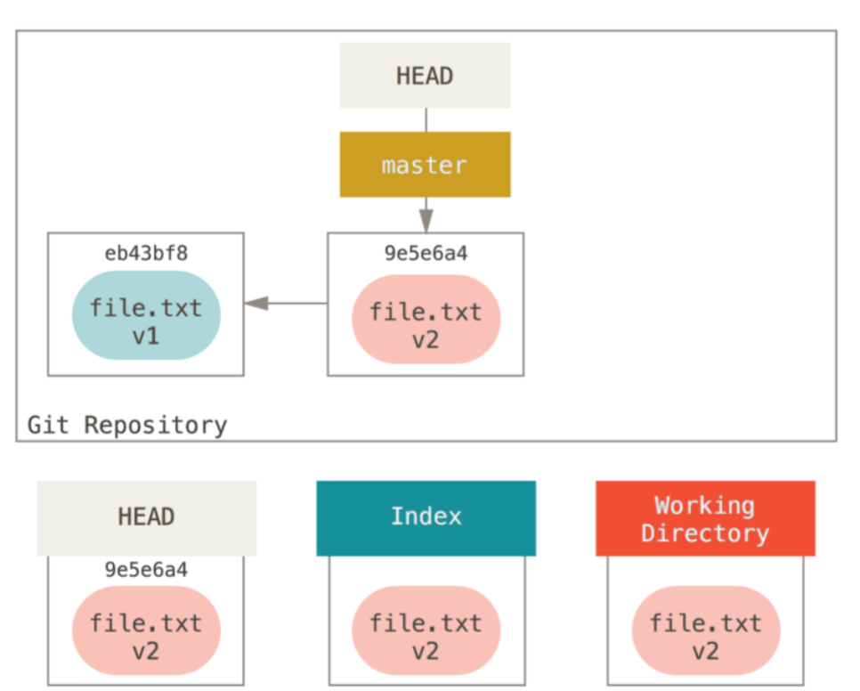
Changes are committed
git commit

Slide 111
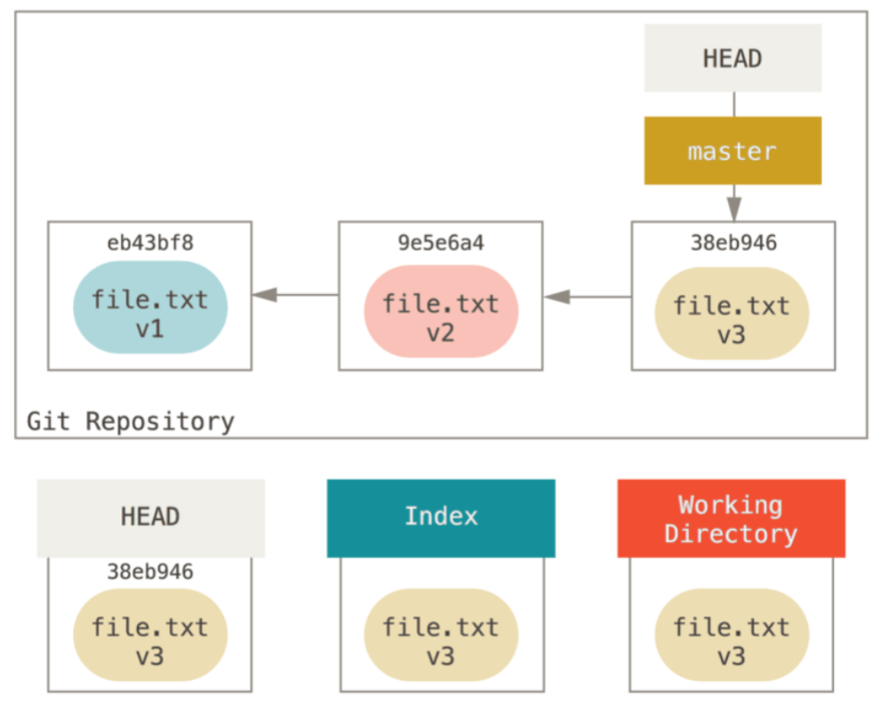
Another changed is added and committed
Modify file.txt
git add file.txt
git commit

Slide 112
What reset does?
Rest manipulates that 3 threes (working dir, index, HEAD)

Slide 113
Soft reset
git reset --soft [commit_pointer]
Moves head and branch to the specified commit
Stops
Note: it doesn’t touch two other threes

Slide 114
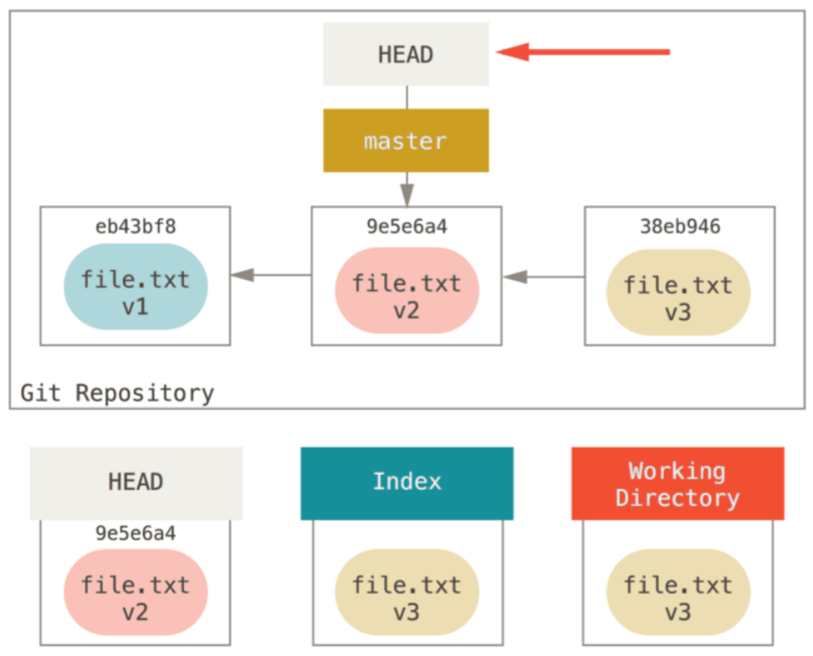
After soft reset
Changes from the last commit are in the working dir and in index (ready to commit)
Commit v3 became detached
Note: gives an ability to change latest commit (like amend does), but allows to modify several commits (Squashing)

Slide 115
Mixed reset
git reset --mixed [commit_pointer] (git reset by default)
Moves head and branch to the specified commit
Changes index to the new HEAD state
Stops
Note: it doesn’t touch working dir

Slide 116
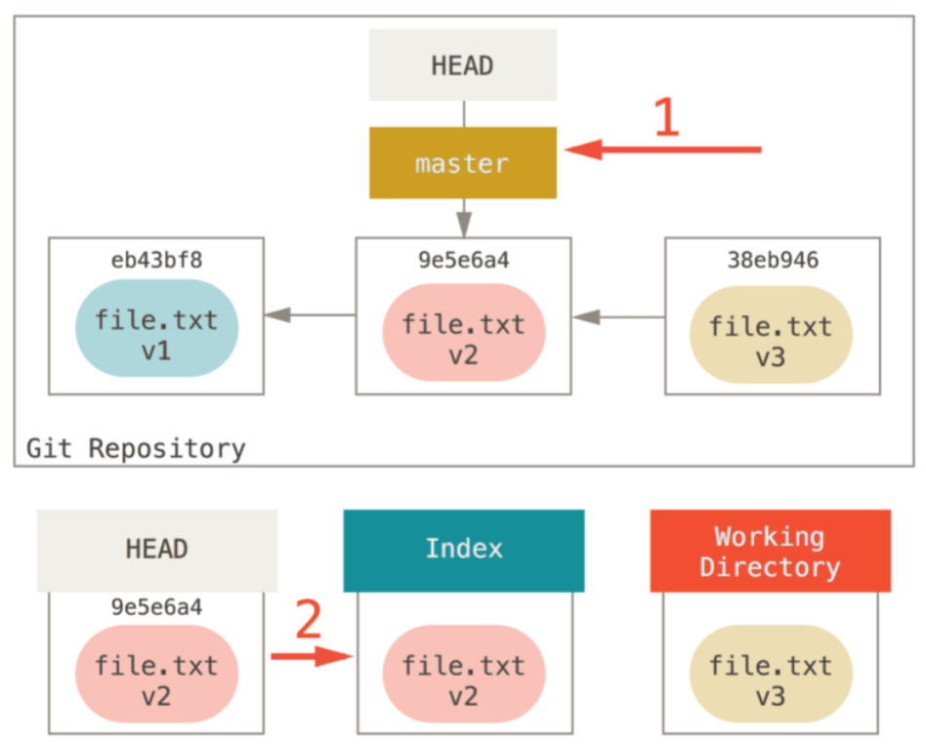
After mixed reset
Changes from the last commit are only in the working dir (ready to add)
Commit v3 became detached

Slide 117
Hard reset
git reset --hard [commit_pointer]
Moves head to the specified commit
Changes index to the new HEAD state
Overrides working dir to the new HEAD state (all working dir changes are lost)
Stops
Note: before running hard rest you should make sure that working dir has any changes that can be lost

Slide 118
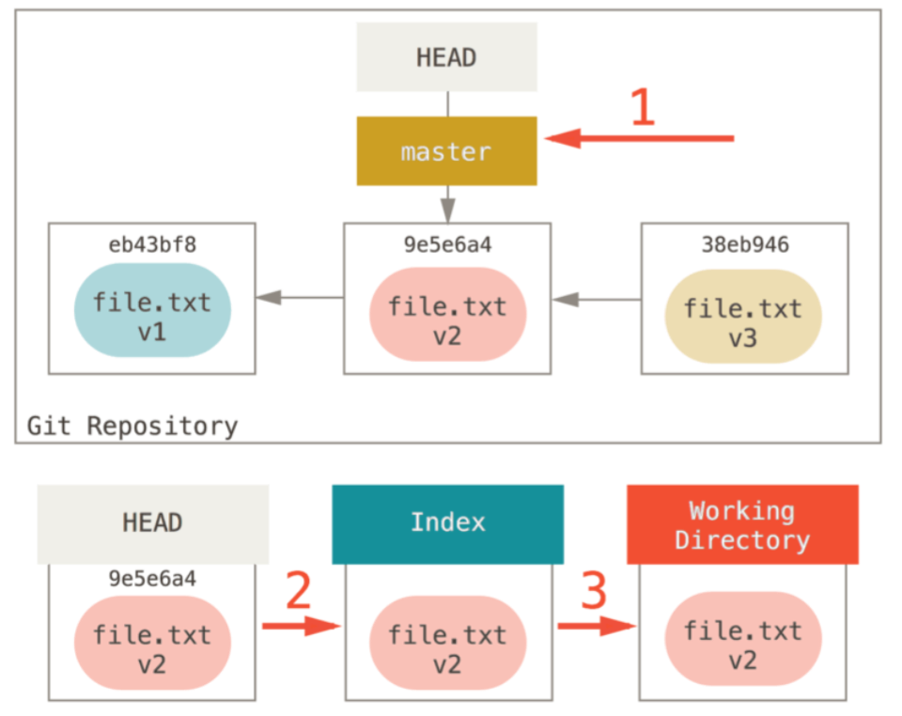
After mixed reset
Changes from the last commit are only in detached commit

Slide 119
Reset with path
git reset file.txt
Takes state of file.txt from HEAD and puts in to index and to working dir (if --hard is specified)
git reset commit_hash -- file.txt
The same as above but takes state from specified commit

Slide 120
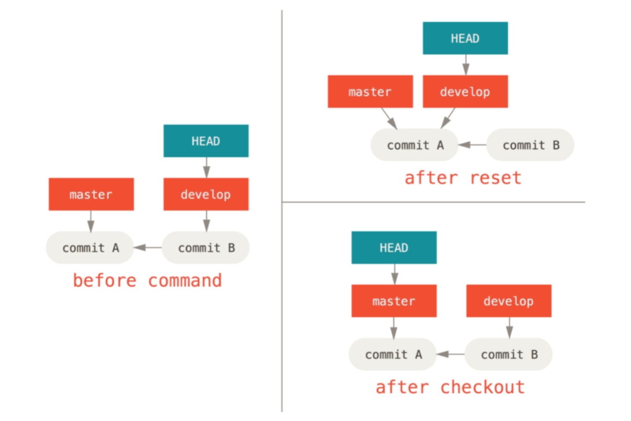
Reset vs Checkout without path
Checkout move HEAD (doesn’t move branch)

Slide 121
Reset vs Checkout with path
git checkout commit_hash -- file.txt
It is not working dir safe (you can loose working dit changes)

Slide 122
Reverting changes

Slide 123
Modifying previous commit
Made desired changed;
Stage the changes (git add);
git commit --amend;
Specify new commit message if needed;
It will modify previous commit
Note: don’t do it with remote commits

Slide 124
Unstaging a Staged File
git reset HEAD f1.txt
removes staged changes. Changes became working dir changes
Note: command git reset can be dangerous but only in case if it is run with --hard option

Slide 125
Unmodifying a Modified File
git checkout -- f1.txt
Reverts current working dir file changes by replacing the file by the staged version.
Note: since it replaces the file that contain changes that are not recorded to git yet, it is not possible to undo this operation

Slide 126
Restore commits

Slide 127
Restore dangling commit
git reflog shows history of HEAD moves for the last 90 days (gc.reflogexpire) or git log –g
git fsck shows all dangling commits and dangling blobs
https://git-scm.com/book/ru/v1/Git-изнутри-Обслуживание-и-восстановление-данных
NOTE: files can be restored only locally (dangling objects are note pushed to remotes)

Slide 128
Distributed Workflows

Slide 129
Centralized Workflow
Shared Repository
pull/push
pull/push
pull/push
Dev1 private
Dev2 private
Dev3 private
pull, merge, commit, push

Slide 130
Centralized Workflow Description
Each developer clones remote repository;
Make and commit some work;
Pull changes, made by other developers from remote;
Pushes own changes to remote;
In this case, remote works like centralized integration point

Slide 131
Integration-Manager Workflow
Official Repository
Dev1 public
Dev2 public
Integration Manager
Dev1 private
Dev2 private

Slide 132
Integration-Manager Workflow Description
Project maintainer (integrator) pushes to the official public repository;
Developer (contributor) clones official and makes changes;
Contributor pushes changes to the own public repository;
Contributor lets maintainer know that changes are ready to be integrated;
Maintainer adds contributor's public as remote, merges locally;
Maintainer pushes changes to the Official public repository;

Slide 133
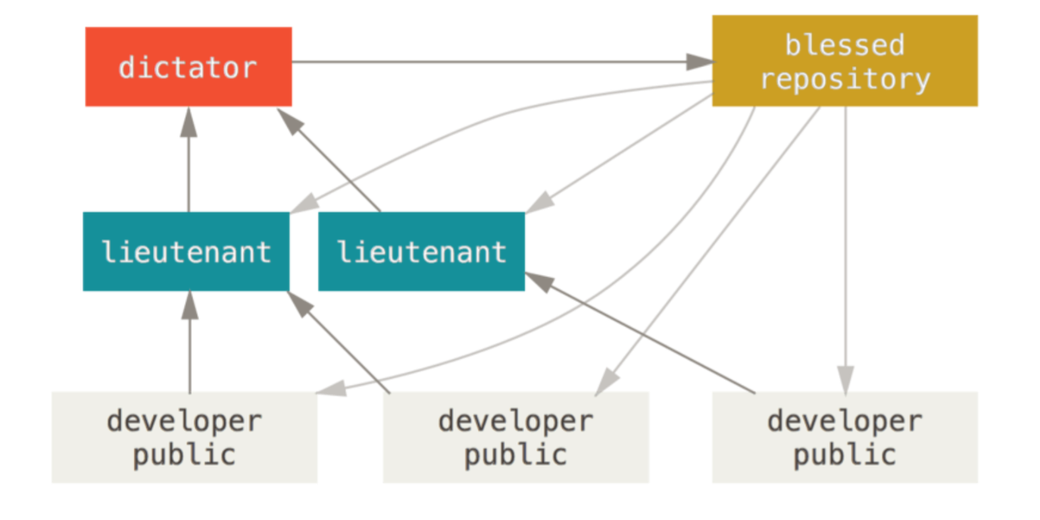
Dictator and Lieutenants Workflow (used by Linux kernel)

Slide 134
Dictator and Lieutenants Workflow description
Several integration managers (lieutenants) are responsible for different parts of repository. One main integrator (dictator) integrates all changes to single repository
Regular developer works on topic branch and then rebases changes on top of master and pushes to the own public;
Lieutenant integrates changes to the own master branch (like Integration-Manager Workflow);
Dictator merges Lieutenant’s changes to the own master branch;
Dictator pushes to the main repository;

Slide 135
Branching Workflow
http://nvie.com/posts/a-successful-git-branching-model/

